Slide 1
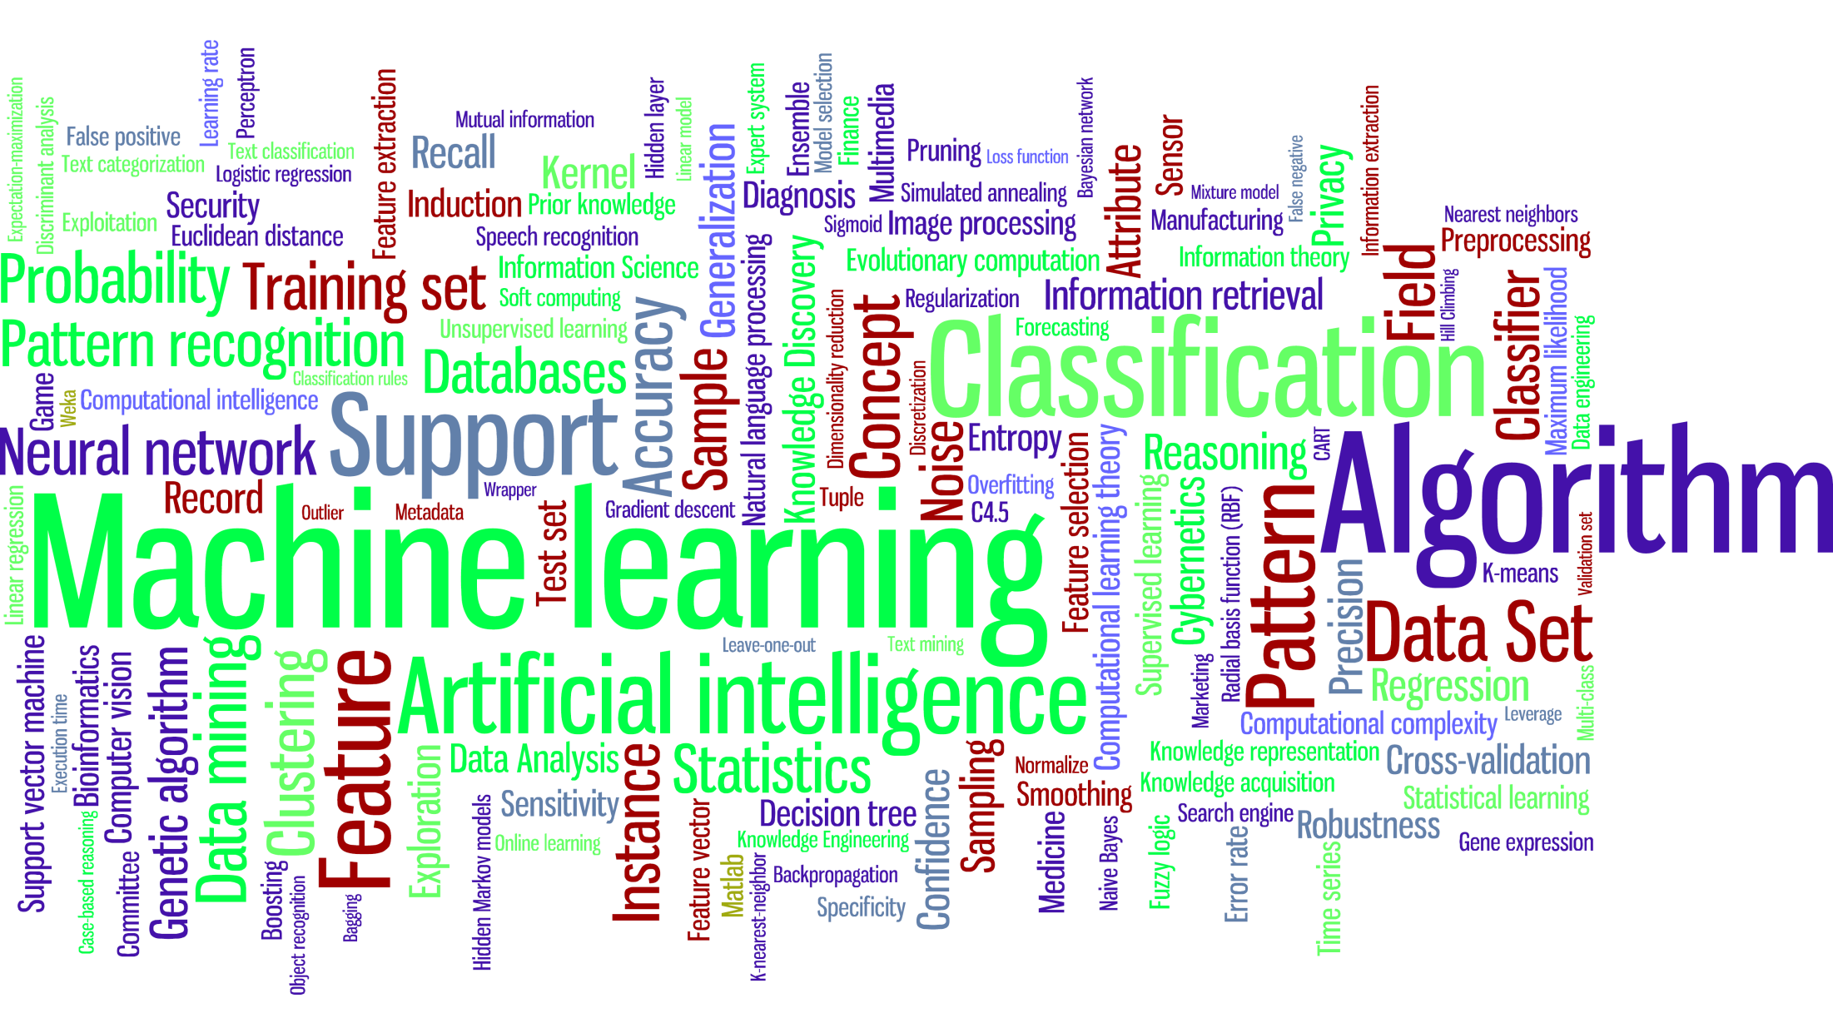
Machine Learning

Slide 2
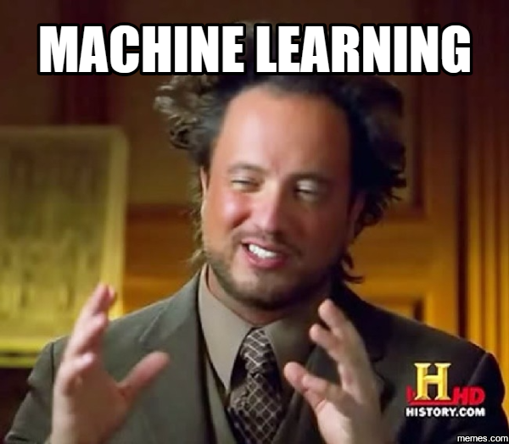
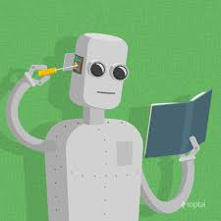
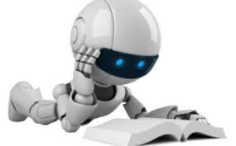
The Big Question-What is Machine Learning?

Slide 3
Why Learn?
Machine learning is programming computers to optimize a performance criterion using example data or past experience.
There is no need to “learn” to calculate Date-of-Birth.
Learning is used when:
Human expertise does not exist (navigating on Mars)
Humans are unable to explain their expertise (speech recognition, visual tracking)
Solution changes in time or no definite solution (predicting stock market)
Solution needs to be adapted to particular cases (facebook friend recommendation)

Slide 4
TECHNICALLY
A computer program is said to learn from experience E with respect to some class of tasks T and performance measure P if its performance at tasks in T, as measured by P, improves with experience E
Learning = Improving with experience at some task
Improve over task T,
With respect to performance measure, P
Based on experience, E.

Slide 5
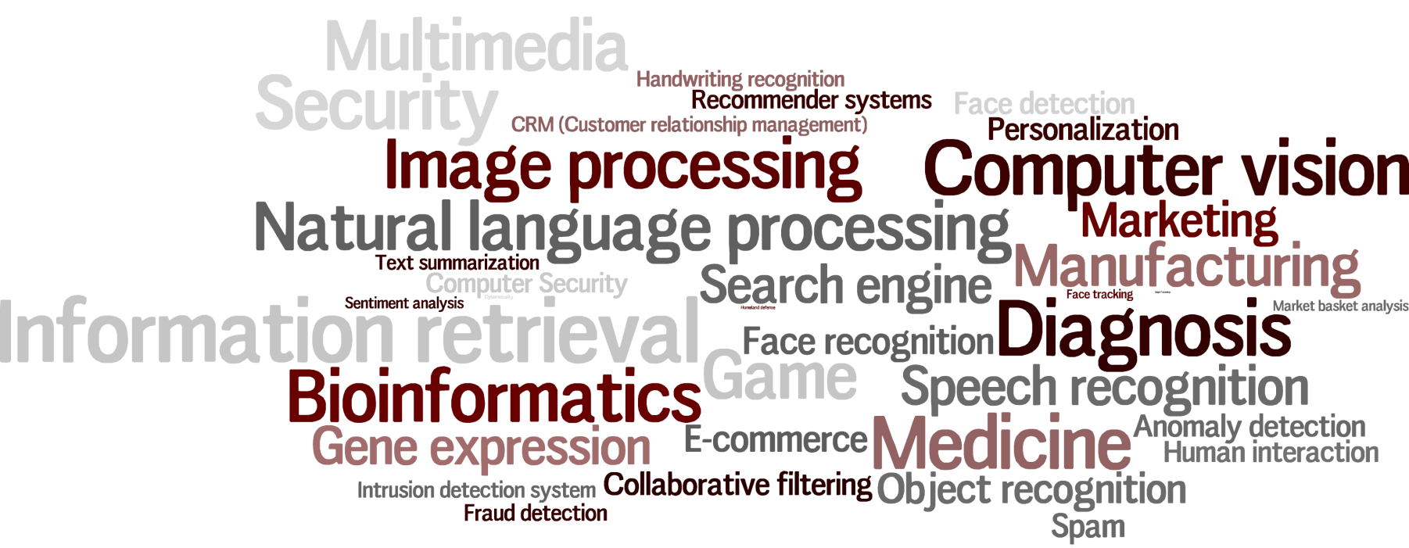
WHERE TO APPLY?

Slide 6
Example applications

Slide 7







RECOMMENDER SYSTEM

Slide 8
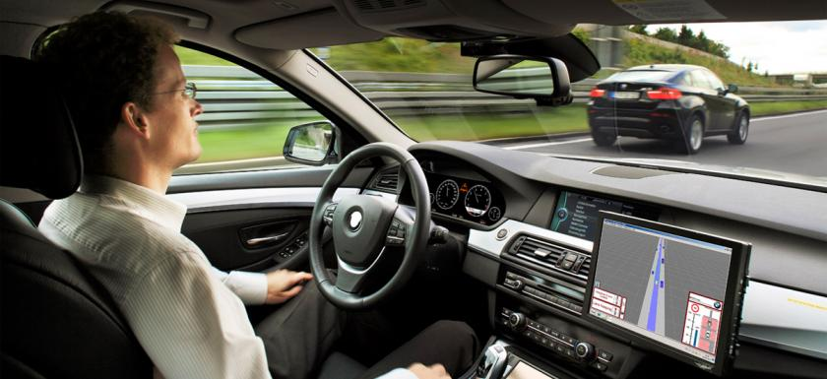
SELF DRIVING CARS

Slide 9
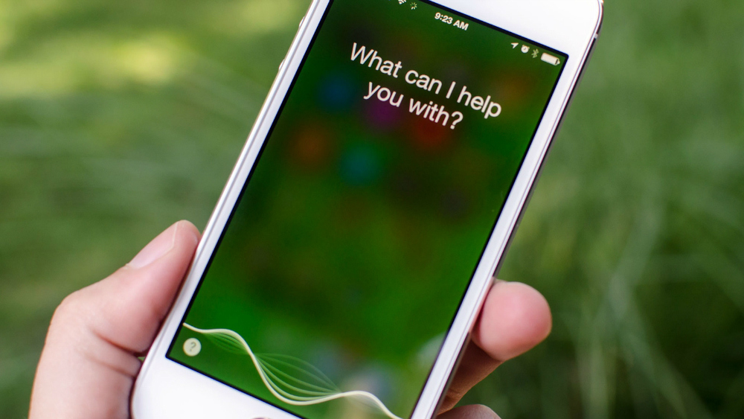
PERSONAL ASSISTANT

Slide 10
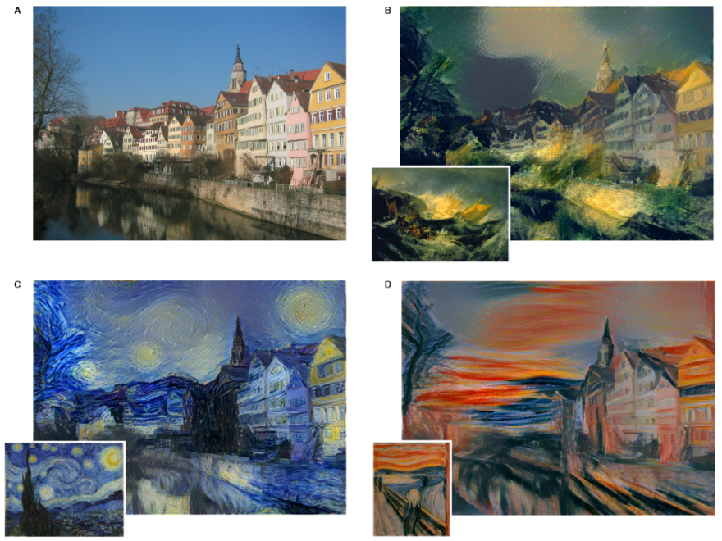
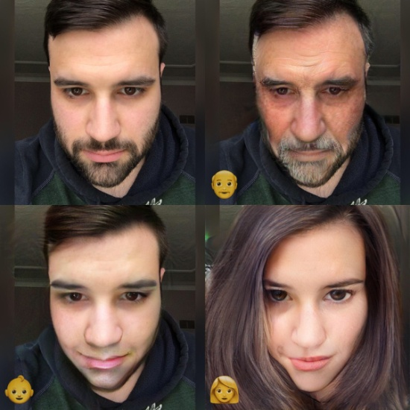
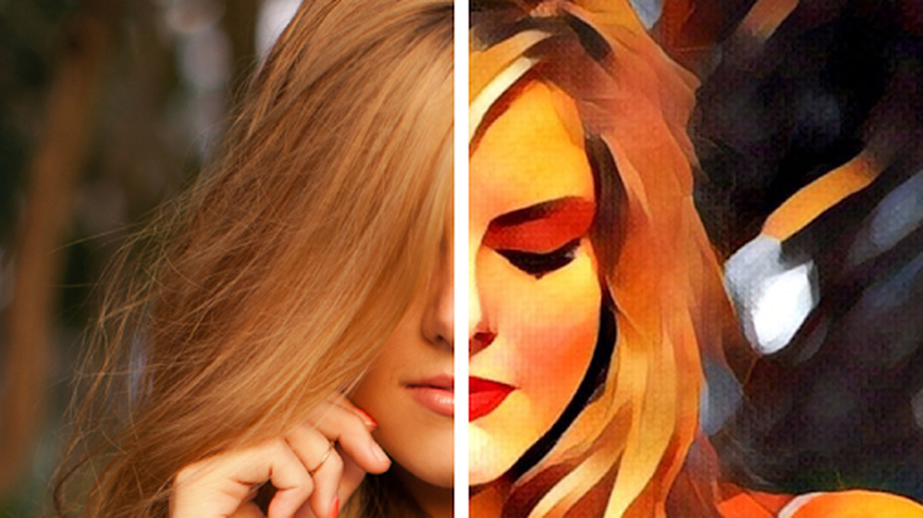
IMAGE MODIFICATION
Style Transfer
Faceapp
Prisma

Slide 11
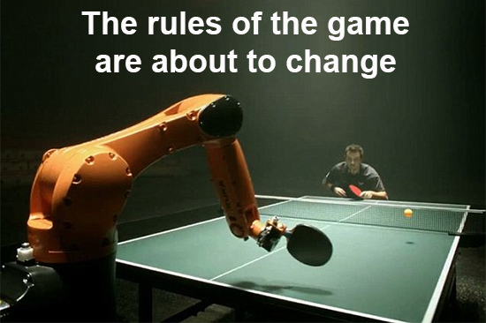
MACHINE LEARNING BOTS

Slide 12
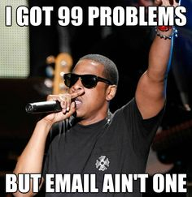
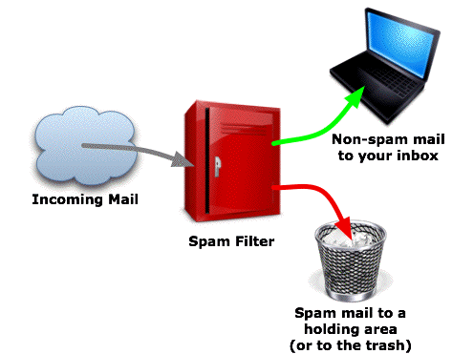
SPAM FILTERING

Slide 13
WHAT IS THE DIFFERENCE?
Traditional Programming
Machine Learning
Data
Computer
Output
Program
Data
Computer
Program
Output

Slide 14
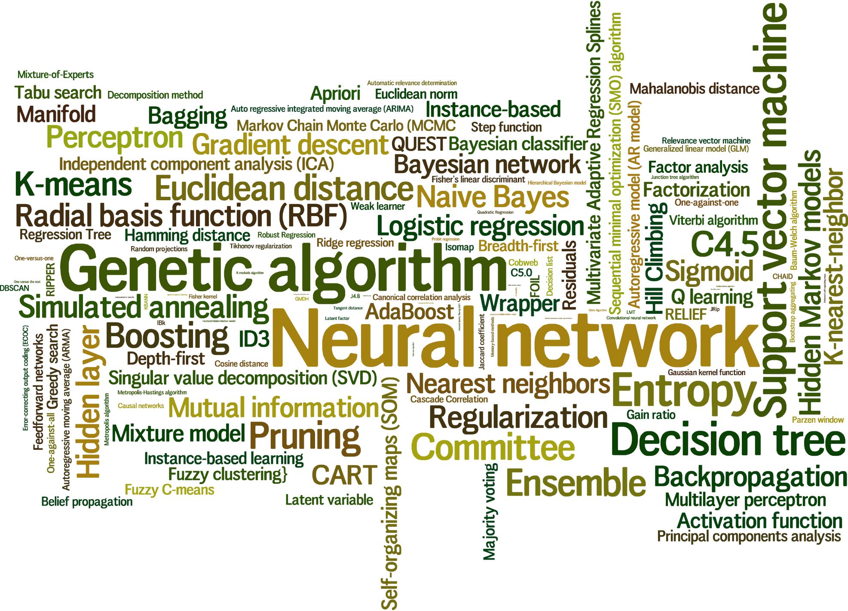
LEARNING ALGORITHM

Slide 15
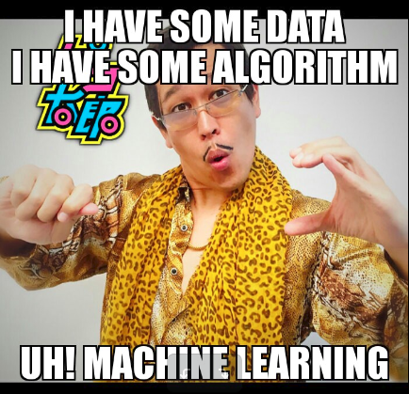
It’s NOT that easy!
Golden Rule
Performance increases.
Should be useful to the community.

